Slide 1
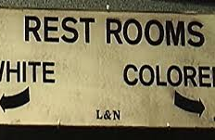
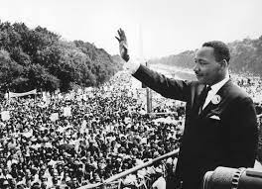
Civil Rights Unit
The Search for Equal Rights

Slide 2
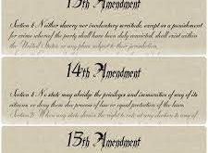
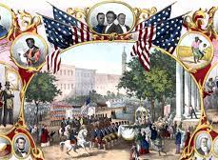
Background
The Civil War ended in 1865 with a Northern victory.
Passage of the 13th, 14th, & 15th Amendments.
13th- Abolished Slavery
14th-Gave African Americans Citizenship and Equal protection under the law.
15th-Gave African American men the right to vote

Slide 3
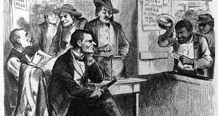
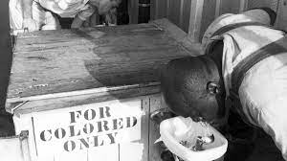
6. Even though on paper African Americans were Equal, these rights were not put into practice in the South

Slide 4
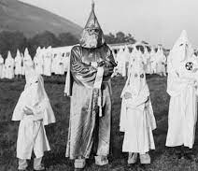
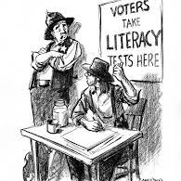
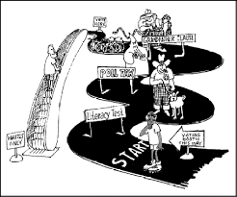
Roadblocks to Equal Rights
1. Literacy tests, Poll Tax, and Grandfather Clauses all kept blacks living in the South from enjoying their Constitutional Rights.
2. KKK terrorized people to prevent African Americans from exercising their rights

Slide 5
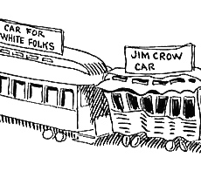
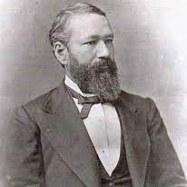
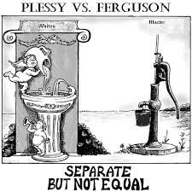
More Roadblocks to Equal Rights
3. Major Supreme Court Case: 1896- Plessy vs Ferguson- Supreme Court stated that there can be “Separate but Equal” facilities. Colored only, and white only. Ex. schools, restaurants, restrooms, etc

Slide 6
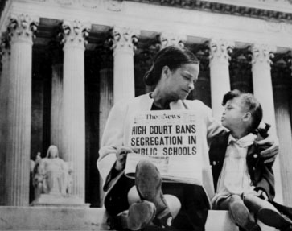
Brown vs Board of Education
1. The separate facilities for African Americans were rarely equal to those of whites. Far less money was spent on all black schools, restrooms and all public facilities.
2. 1954, Supreme Court finally overturned the Plessy vs Ferguson case.
3. The Brown vs the BD. of Education case stated that separating races in public facilities is unconstitutional.

Slide 7
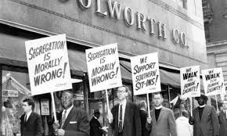
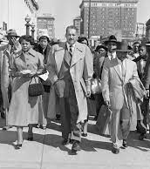
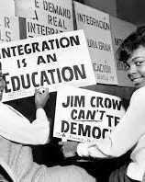
More Brown vs. BOE
4. The court victory was a major victory for the NAACP- Head lawyer for the NAACP was Thurgood Marshall.
5. The South had no choice but to integrate their public facilities

Slide 9
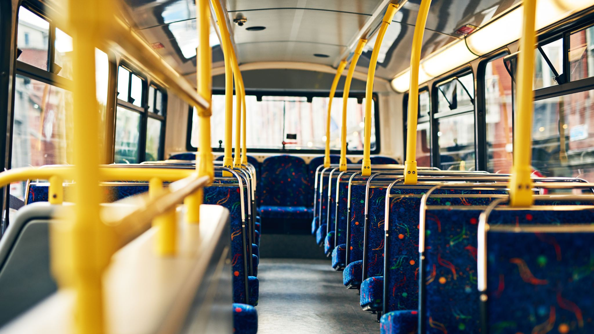
Montgomery Bus Boycott

Slide 10
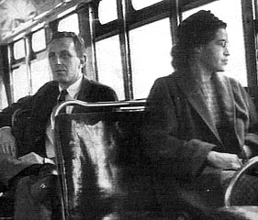
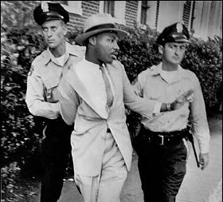
Montgomery Bus Boycott Continued
1. Rosa Parks incident- Montgomery Alabama-she refused to give up seat to a white man on a public bus.
2. Parks jailed and fined.
3. 26-year-old Martin Luther King rose to a leadership role.
4. NAACP-organized a bus boycott on all city buses.

Slide 11
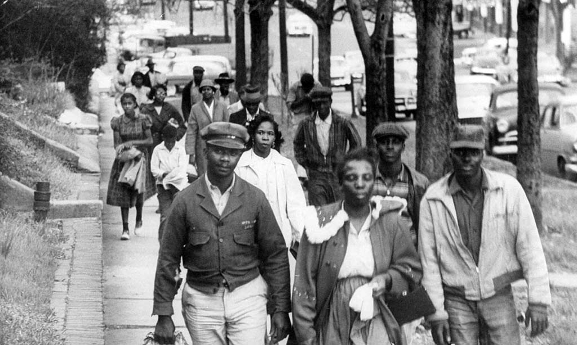
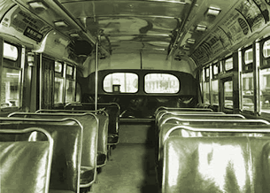
Montgomery Bus Boycott Continued…
5. Residents car-pooled, walked, biked, did whatever to travel, except ride and pay for public bus transportation.
6. After a year of most buses sitting idle, the Supreme Court ruled that Montgomery’s bus segregation law illegal

Slide 12
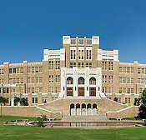
Little Rock Arkansas

Slide 13
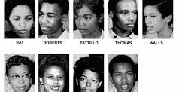
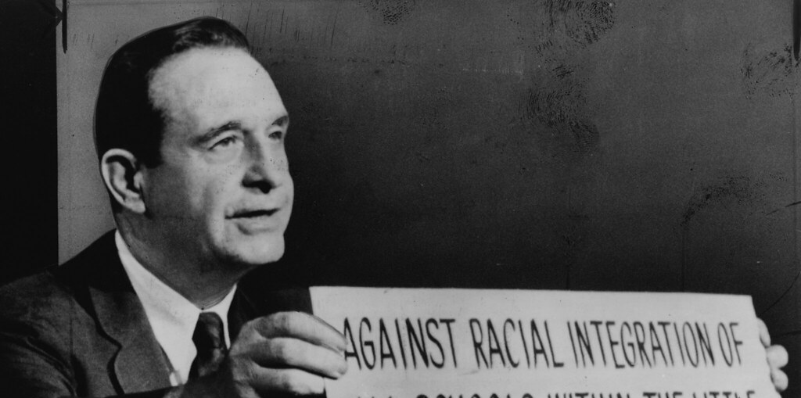
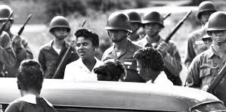
Little Rock Cont…
1. 1957- Arkansas-9 African American students were scheduled to attend the previously all white Central High School.
2. Governor Orval Faubus opposed the decision in the Brown vs BD. of Ed case.
3. He ordered the Arkansas Nat’l. Guard to surround Central High and prevent the integration of the school.

Slide 14
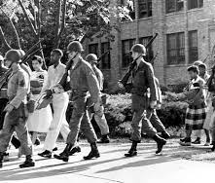
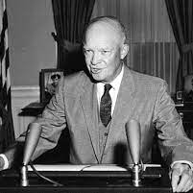
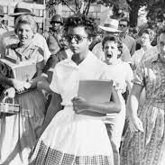
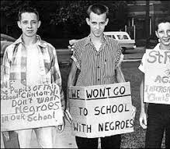
Little Rock Cont…
4. An angry mob also surrounded the school shouting insults at the students.
5. Pres. Eisenhower realized the federal gov’t had to act- He ordered the 101’st Airborne division to enforce the court order.
6. The “Little Rock 9”, were driven to school and escorted to their classrooms with soldiers fully armed.

Slide 15
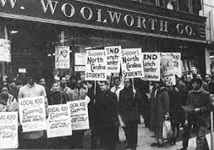
Sit-ins at Lunch Counters

Slide 16
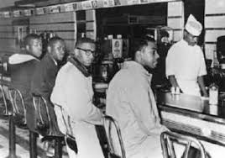
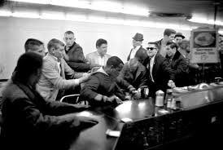
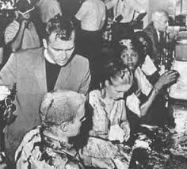
Sit-ins at Lunch Counters Cont…
1. On Feb. 1, 1960, 4 black students walked into a Woolworth’s store in Greensboro N.C. They sat down at the lunch counter and were refused service.
2. Students began a sit-in: They refused to move until their demands were met.
3. Students black and white who were trained in non-violence methods spent months in 15 southern cities.

Slide 17
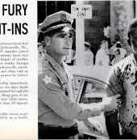
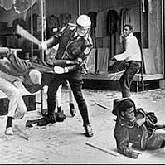
Sit-ins at Lunch Counters Cont..
4. Students were beat, burned with cigarettes, and had food dumped all over them.
5. Sit-Ins attracted national sympathy- store owners gave in because of revenue lost and began serving all.

Slide 18
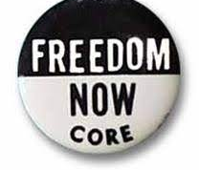
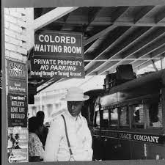
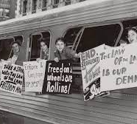
Freedom Riders

Slide 19
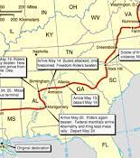
Freedom Riders – Cont..
1. CORE: the civil rights group, planned a series of freedom rides through segregated cities in the South.
2. At terminals along the route, blacks would try to use “whites only” waiting rooms, bathrooms, and drinking fountains.
3. The freedom riders expected violence and they got it. Riders were beaten and buses burned.

Slide 20
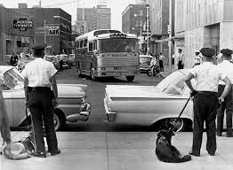
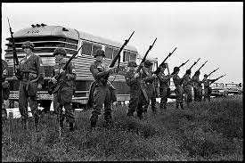
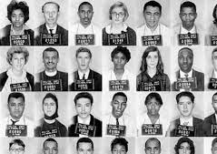
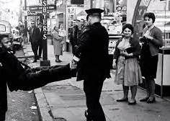
Freedom Riders Cont…
4. Police in Jackson Miss. Turned dogs and fire hoses on protesters.
5. JFK sent federal agents to protect civil rights workers and protestors.
6. Southern states hated federal agents coming down into their state and telling them how to run their affairs.

